Slide 1
William Stallings
Computer Organization and Architecture
7th Edition
Chapter 17
Micro-programmed Control

Slide 2
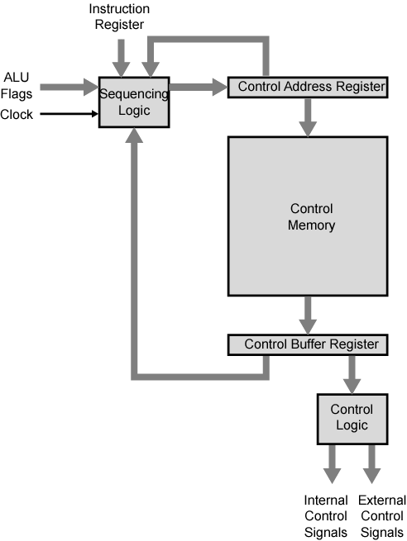
Control Unit Organization

Slide 3
Micro-programmed Control
Use sequences of instructions (see earlier notes) to control complex operations
Called micro-programming or firmware

Slide 4
Implementation (1)
All the control unit does is generate a set of control signals
Each control signal is on or off
Represent each control signal by a bit
Have a control word for each micro-operation
Have a sequence of control words for each machine code instruction
Add an address to specify the next micro-instruction, depending on conditions

Slide 5
Implementation (2)
Today’s large microprocessor
  Many instructions and associated register-level hardware
  Many control points to be manipulated
This results in control memory that
  Contains a large number of words
    co-responding to the number of instructions to be executed
  Has a wide word width
    Due to the large number of control points to be manipulated

Slide 6
Micro-program Word Length
Based on 3 factors
  Maximum number of simultaneous micro-operations supported
  The way control information is represented or encoded
  The way in which the next micro-instruction address is specified

Slide 7
Micro-instruction Types
Each micro-instruction specifies single (or few) micro-operations to be performed
  (vertical micro-programming)
Each micro-instruction specifies many different micro-operations to be performed in parallel
  (horizontal micro-programming)

Slide 8
Vertical Micro-programming
Width is narrow
n control signals encoded into log₂ n bits
Limited ability to express parallelism
Considerable encoding of control information requires external memory word decoder to identify the exact control line being manipulated

Slide 9
Horizontal Micro-programming
Wide memory word
High degree of parallel operations possible
Little encoding of control information

Slide 10
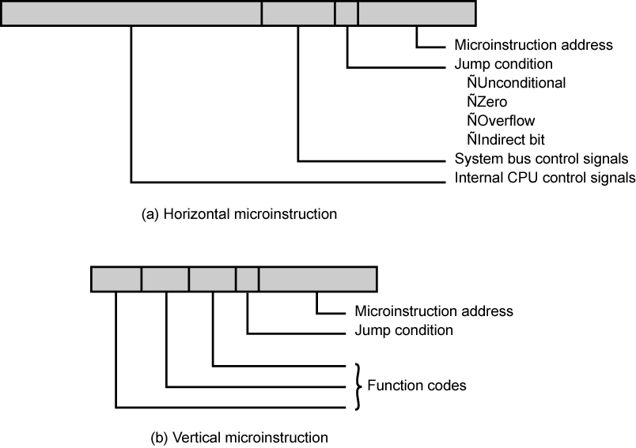
Typical Microinstruction Formats

Slide 11
Compromise
Divide control signals into disjoint groups
Implement each group as separate field in memory word
Supports reasonable levels of parallelism without too much complexity

Slide 12
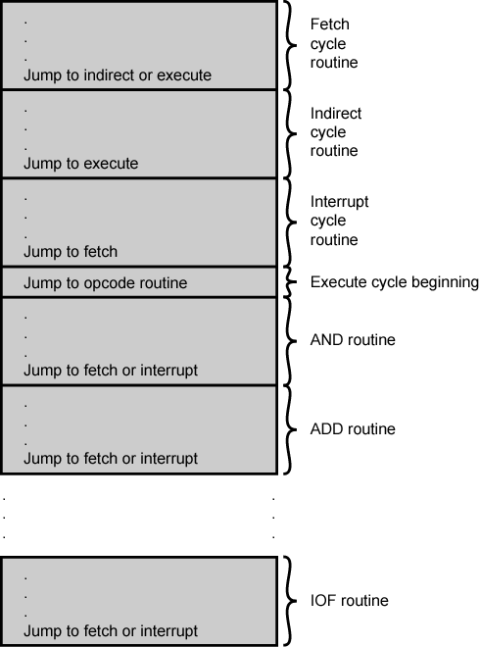
Organization of
Control Memory

Slide 13
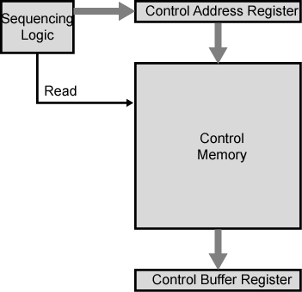
Control Unit

Slide 14
Control Unit Function
Sequence login unit issues read command
Word specified in control address register is read into control buffer register
Control buffer register contents generates control signals and next address information
Sequence login loads new address into control buffer register based on next address information from control buffer register and ALU flags

Slide 15
Next Address Decision
Depending on ALU flags and control buffer register
  Get next instruction
    Add 1 to control address register
  Jump to new routine based on jump microinstruction
    Load address field of control buffer register into control address register
  Jump to machine instruction routine
    Load control address register based on opcode in IR

Slide 16
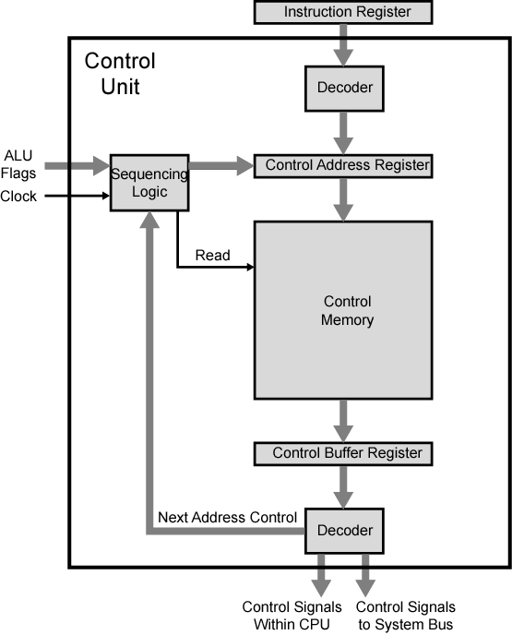
Functioning of Microprogrammed
Control Unit

Slide 17
Wilkes Control
1951
Matrix partially filled with diodes
During cycle, one row activated
  Generates signals where diode present
  First part of row generates control
  Second generates address for next cycle

Slide 18
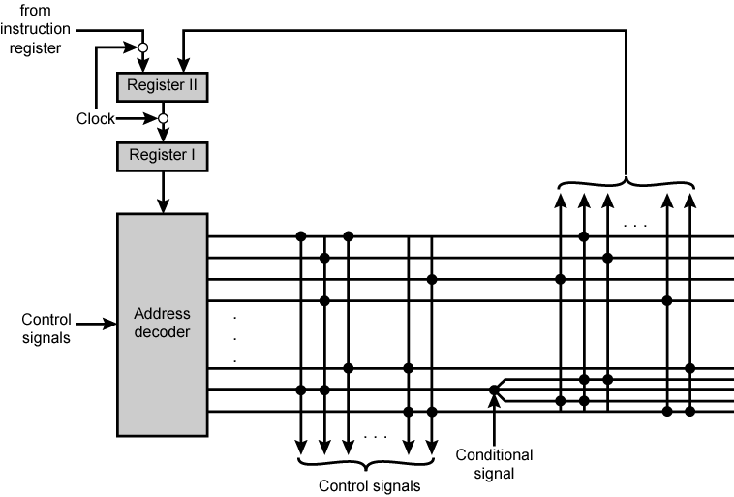
Wilkes's Microprogrammed Control Unit

Slide 19
Advantages and Disadvantages of Microprogramming
Simplifies design of control unit
  Cheaper
  Less error-prone
Slower

Slide 20
Tasks Done By Microprogrammed Control Unit
Microinstruction sequencing
Microinstruction execution
Must consider both together

Slide 21
Design Considerations
Size of microinstructions
Address generation time
  Determined by instruction register
    Once per cycle, after instruction is fetched
  Next sequential address
    Common in most designed
  Branches
    Both conditional and unconditional

Slide 22
Sequencing Techniques
Based on current microinstruction, condition flags, contents of IR, control memory address must be generated
Based on format of address information
  Two address fields
  Single address field
  Variable format

Slide 23
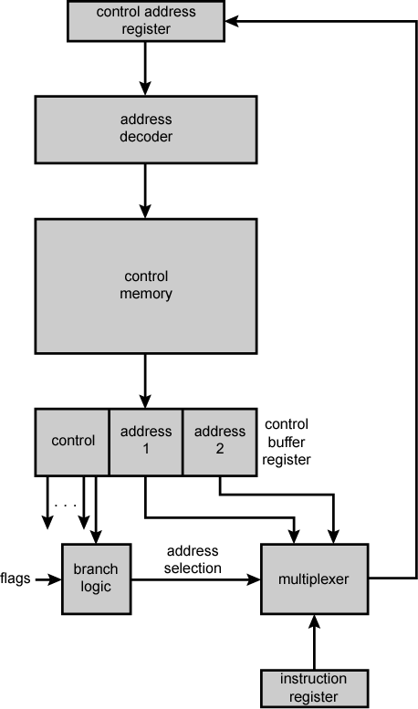
Branch Control Logic:
Two Address Fields

Slide 24
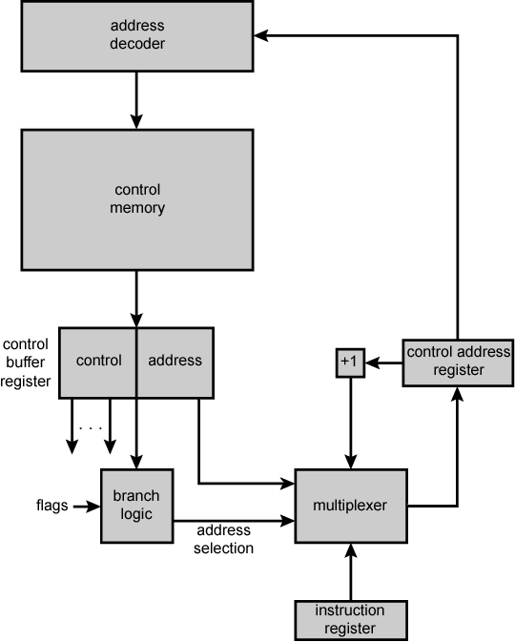
Branch Control
Logic: Single
Address Field

Slide 25
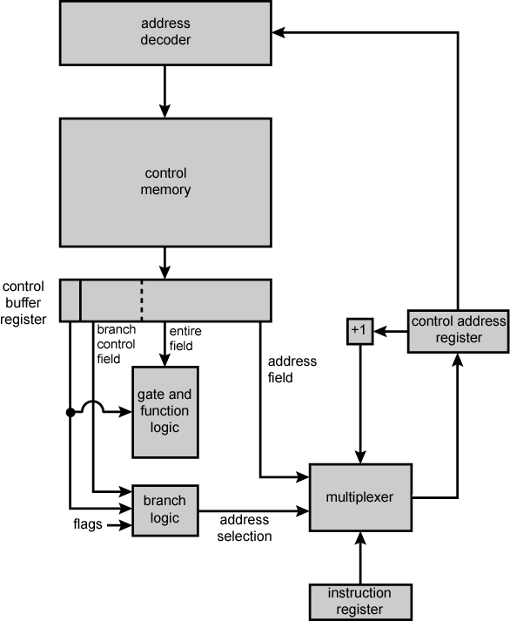
Branch Control
Logic: Variable
Format

Slide 26
Address Generation
Explicit | Implicit
Two-field | Mapping
Unconditional Branch | Addition
Conditional branch | Residual control

Slide 27
Execution
The cycle is the basic event
Each cycle is made up of two events
  Fetch
    Determined by generation of microinstruction address
  Execute

Slide 28
Execute
Effect is to generate control signals
Some control points internal to processor
Rest go to external control bus or other interface

Slide 29
Control Unit
Organization

Slide 30
A Taxonomy of Microinstructions
Vertical/horizontal
Packed/unpacked
Hard/soft microprogramming
Direct/indirect encoding

Slide 31
Improvements over Wilkes
Wilkes had each bit directly produced a control signal or directly produced one bit of next address
More complex address sequencing schemes,
using fewer microinstruction bits, are possible
Require more complex sequencing logic module
Control word bits can be saved by encoding and subsequently decoding control information

Slide 32
How to Encode
K different internal and external control signals
Wilkes’s:
  K bits dedicated
  2K control signals during any instruction cycle
Not all used
  Two sources cannot be gated to same destination
  Register cannot be source and destination
  Only one pattern presented to ALU at a time
  Only one pattern presented to external control bus at a time
Require Q < 2K which can be encoded with log2Q < K bits
Not done
  As difficult to program as pure decoded (Wilkes) scheme
  Requires complex slow control logic module
Compromises
  More bits than necessary used
  Some combinations that are physically allowable are not possible to encode

Slide 33
Specific Encoding Techniques
Microinstruction organized as set of fields
Each field contains code
Activates one or more control signals
Organize format into independent fields
  Field depicts set of actions (pattern of control signals)
  Actions from different fields can occur simultaneously
Alternative actions that can be specified by a field are mutually exclusive
  Only one action specified for field could occur at a time

Slide 34
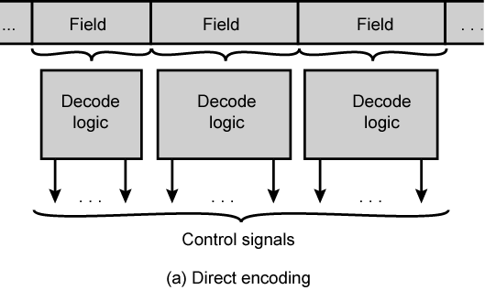
Microinstruction Encoding
Direct Encoding

Slide 35
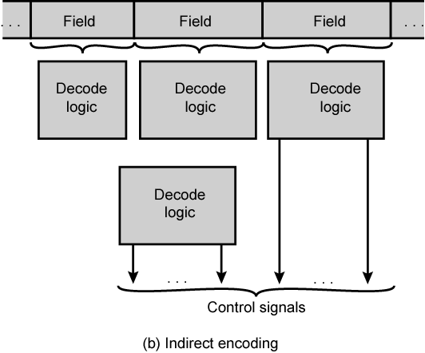
Microinstruction Encoding
Indirect Encoding

Slide 36
Required Reading
Stallings chapter 17

